Slide 1

AI Is Rewriting Benefits: What HR Must Do Before Open Enrollment
June 11, 2026

Slide 2

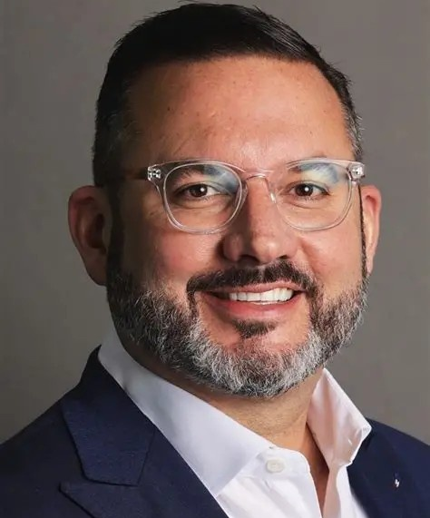
Today’s
Speaker
Dan Thompson
Chief Benefits Officer
Vensure

Slide 3

Today’s
Speaker
Guy Benjamin
Co-Founder CEO
Healthee

Slide 4

Table of Contents
01. Today’s Open Enrollment Landscape
02. The Rise of AI in Benefit Decision Making
03. Best Practices for Modern Open Enrollment
04. How AI Assists Humans in Healthcare
05. AI Recommendations for Humans
Notes:
Poll Question #1:

Slide 5
The State of Today’s Open Enrollment Landscape
What’s changing in employee expectations.
The complexity of benefits selection for SMBs and employees.
Common challenges HR teams face during open enrollment.
Why traditional enrollment methods are no longer enough.

Slide 6
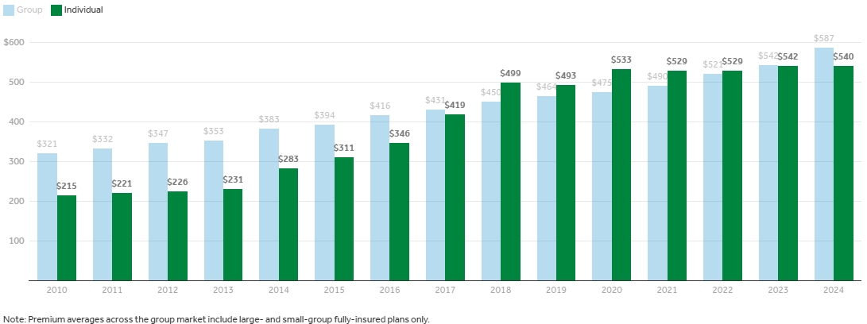
Average Monthly Health Insurance Premiums, by Market Segment, 2010-2024, Continuing to Increase
Source: KFF analysis of data from Mark Farrah Associates Health Coverage Portal™ Annual Exhibit of Premiums, Enrollment and Utilization (NAIC)

Slide 7


The Rise of AI in Benefits Decision‑Making
Why the shift from manual decision‑making to data‑driven guidance.
Real examples of AI tools supporting employees during enrollment.
Major medical, dental, vision, pet, and worksite products.
AI in benefits reduces confusion, improves accuracy, and increases confidence.
Notes:
Poll Question #2:

Slide 8



How AI Enhances the Open Enrollment Experience
Personalized Benefits Recommendations
Reducing Administrative Burden for HR Teams
Improving Employee Satisfaction and Engagement

Slide 9

“AI has evolved from a theoretical concept into a practical force reshaping the modern workplace.”
Source: SHRM, State of AI in HR 2026 Report.

Slide 10

Best Practices for Modern Open Enrollment
How to prepare employees for an AI‑supported enrollment.
Communication strategies that increase participation.
Tools and resources HR teams should leverage.
How to evaluate AI solutions for benefits, compliance, and accuracy.

Slide 11

How AI Assists Humans in Navigating Healthcare
AI as a support system, not a replacement.
Guiding employees toward cost‑effective, high‑quality care.
Reducing decision fatigue and improving outcomes.

Slide 12
AI‑Driven Recommendations:
Empowering Better Benefits Decisions
How AI Analyzes Data to Make Personalized Recommendations
Examples of AI‑generated Insights Employees Can Trust
How AI Helps Employees Avoid Under‑ or Over‑insuring

Slide 13
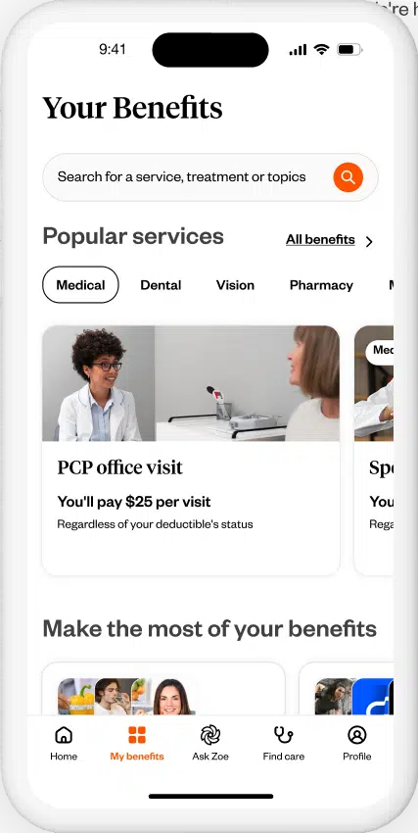
VensureHR + Healthee:
Delivering a Better
Benefits Experience
Why this collaboration matters.
How both organizations are working to simplify open enrollment.
The shared mission: empowering employees and supporting HR teams.
Notes:
Poll Question #3:

Slide 14

Use as second to last slide if you want a Q&A section after the presentation.
QUESTIONS?

Slide 15

Scan to Learn More.

Slide 16
Thank you
for your time.

